Slide 1



What do we teach & how?
Dr Kevin Dyer
Academic Director
QUB Doctorate in Clinical Psychology
Consultant Clinical Psychologist

Slide 2

What informs our curriculum…
We aim to train reflective scientist-practitioners to meet the workforce needs of Northern Ireland
The content is informed by:
Standards of proficiency HCPC
BPS guidance
Feedback from services
Many key stakeholders who continuously review our teaching content:
Representatives of BPS DCPNI SIGs
Trainees
Experts by experience
School of Psychology
External Examiners

Slide 3
Academic Modules
There are three academic modules corresponding with each year of the programme:
  PSY9053 Clinical Psychology 1
  PSY9054 Clinical Psychology 2
  PSY9055 Clinical Psychology 3
There are three summative assessments associated with each module in the form of a clinical case study:
  Clinical Report 1
  Clinical Report 2
  Clinical Report 3

Slide 4
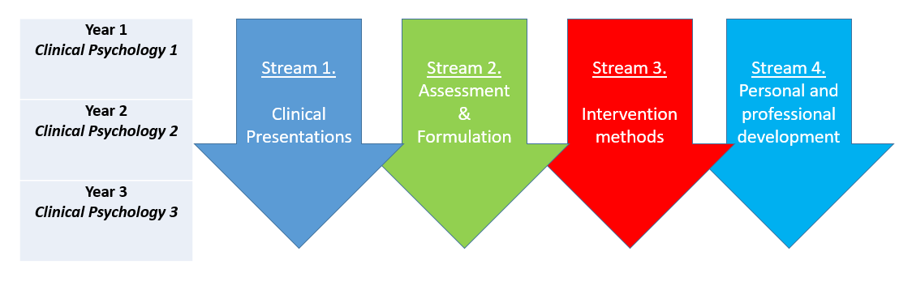
Topic Streams

Slide 5
PSY9053 Clinical Psychology 1
Clinical Presentations
  Anxiety, Depression, PTSD, OCD etc.
Assessment and Formulation
  AMH assessment, Risk, CBT formulation etc
Intervention Methods
  CBT, Psychodynamic, CFT etc
Personal & Professional Development (PPD)
  Personal Awareness Groups

Slide 6
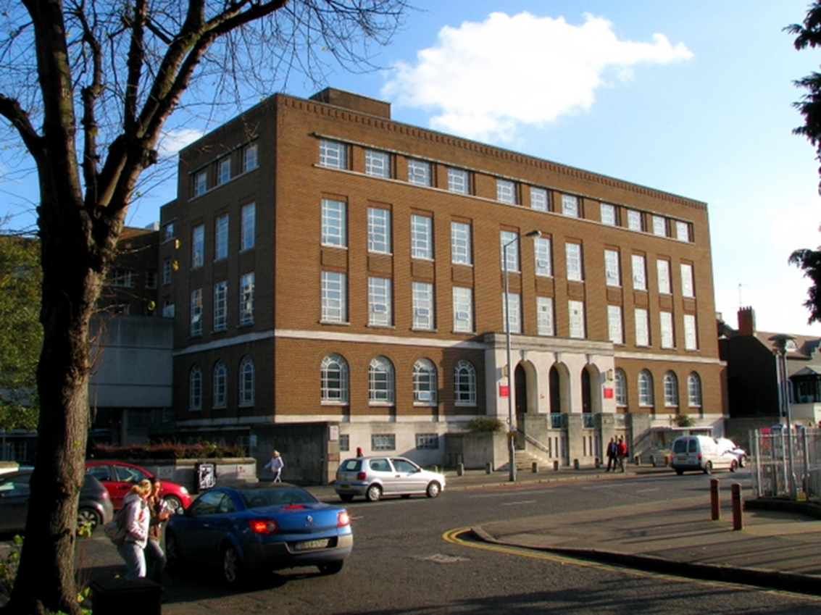

Teaching days…
There are regular teaching days:
Teaching days comprise 4 x 1.5 hour sessions
Number of teaching days varies across the year:
  An initial block, then one or two days per week
  Teaching runs from Sept – June
Teaching is generally led by experts in the field:
Clinical psychologists in the HSC
Course team staff
Guest lecturers

Slide 7
Assessments
Modular course: Each module includes an assessment:
Summative
Case studies
Formative
Observed role play
Peer development through reflective practice groups

Slide 8
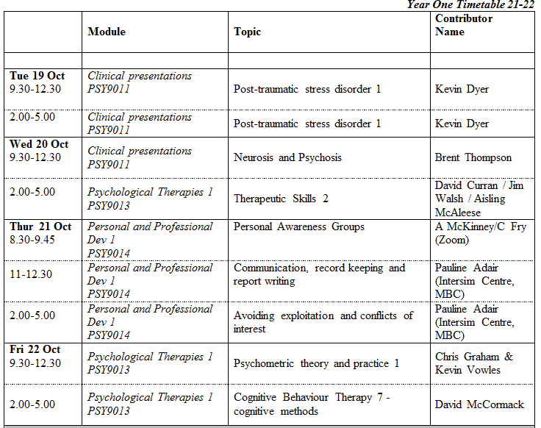
What we aim to cover and achieve in our teaching…
Provide trainees with high quality, expert teaching that forms the foundation for skills they will further develop and implement in clinical placements
Provide trainees with the opportunity to practice, reflect, and develop understanding of skills associated with assessment, formulation, and intervention
Provide gold standard teaching materials and skills that can be consulted and used by trainees in their post-qualification career
Provide a secure academic base during training within a university setting and among colleagues who share their experience

Slide 9
Summary
Substantive amount of expert-led, tailored teaching to fully resource trainees for their clinical work as well as develop reflective and scientist practitioner skills pertaining to relevant social issues
Teaching spans across the three years within teaching blocks and alongside placements
Teaching delivered mainly by clinical psychologists working in the HSC who are experts in their field
Focus is to develop theory-practice links in assessment, formulation and intervention across the life span
Main assessment method is detailed case studies reflecting actual clinical work

Slide 10


Thank you

